Slide 1

Health care
Medical Costs

Slide 2
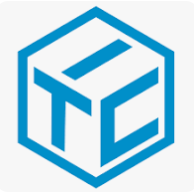
Medical Costs
Medical costs refer to the expenses incurred for medical services and treatments. These costs can vary widely depending on several factors, including the type of medical services, geographic location, patient demographics, and individual health conditions.
It includes various attributes such as age, sex, BMI, number of children, smoking status, and region. These attributes are essential in understanding the factors that influence medical costs and can be used for predictive modelling, statistical analysis, and research purposes.

Slide 3
Use case
Trend Analysis of Medical Costs by Age:
Analize how medical costs vary across different age groups to identify which age groups incur the highest expenses and for which types of services
Impact of BMI on Medical Costs:
Investigate the correlation between BMI and medical costs to understand how weight management programs could potentially reduce healthcare expenses.
Smoking and Medical Costs:
Compare the medical costs of smokers versus non-smokers to quantify the financial impact of smoking on healthcare systems.

Slide 4
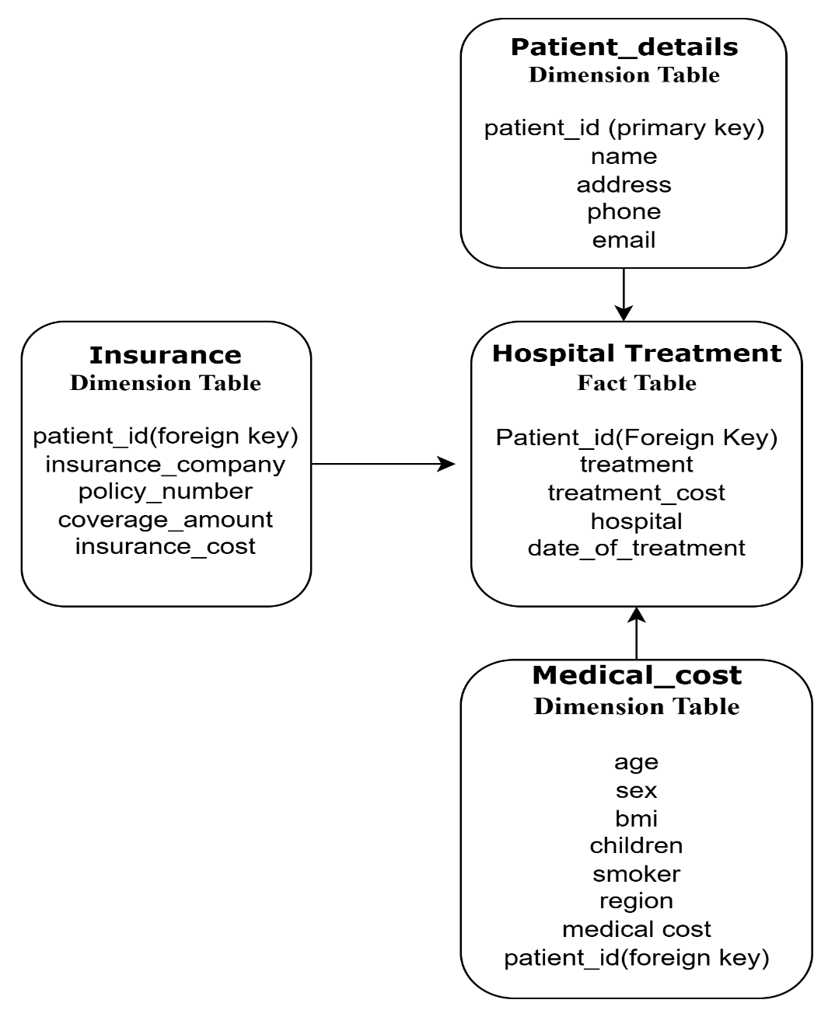
Data model – star schema

Slide 5
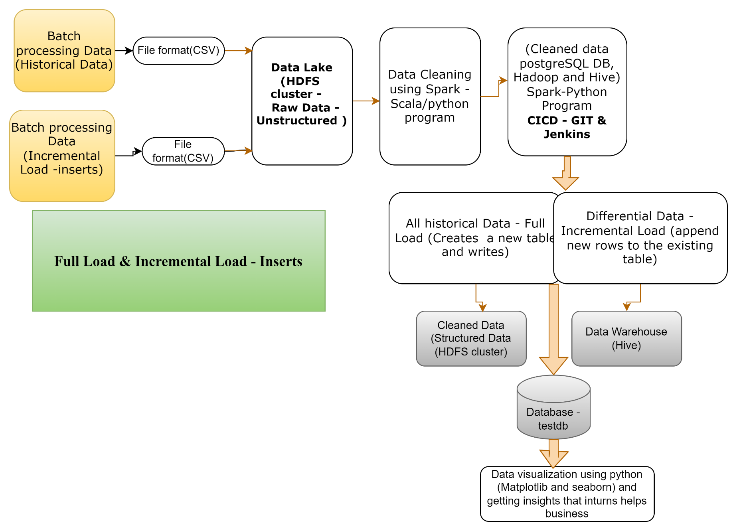
End to end flow of project

Slide 6
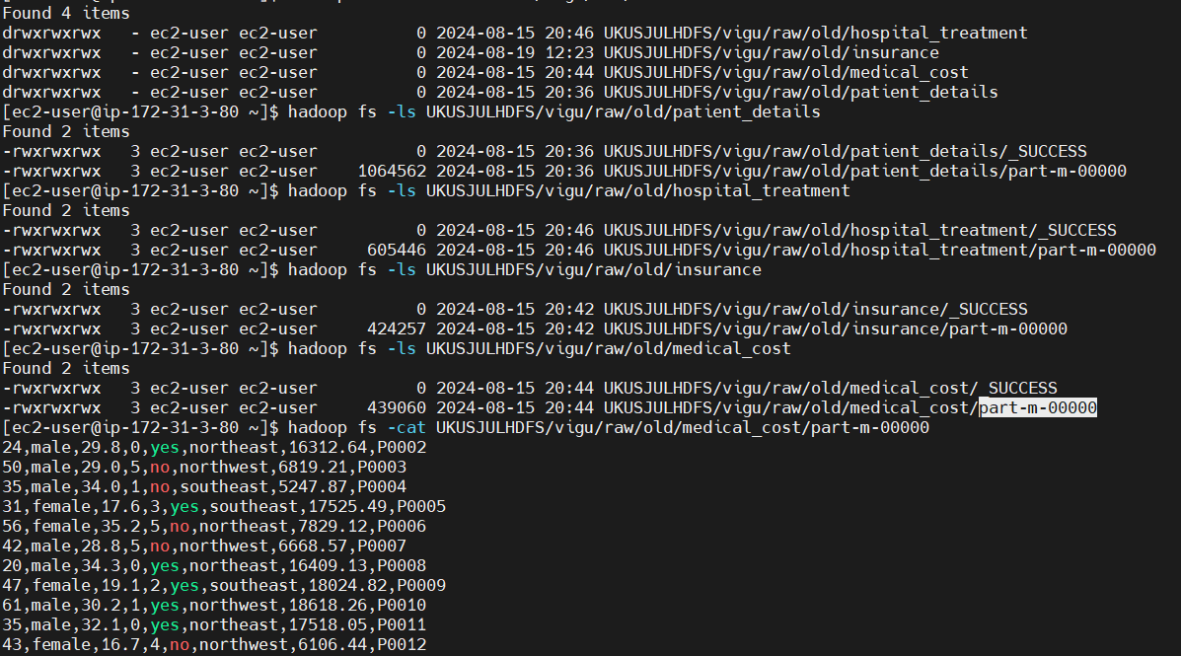
Raw data injected into data lake

Slide 7
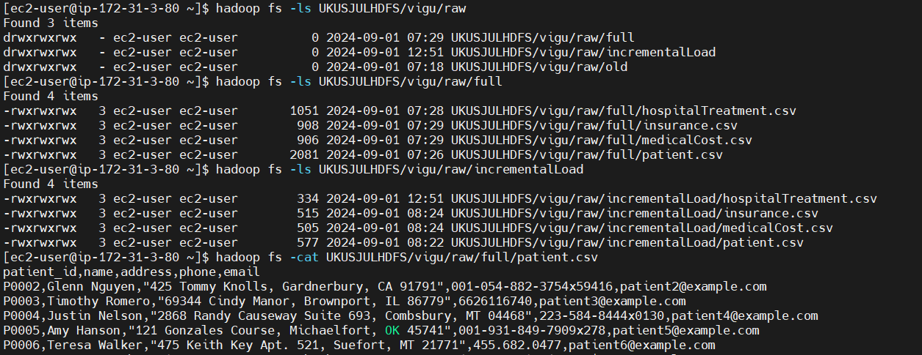
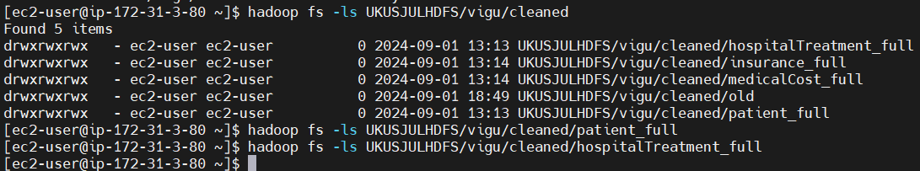
Full Load and incremental load

Slide 8
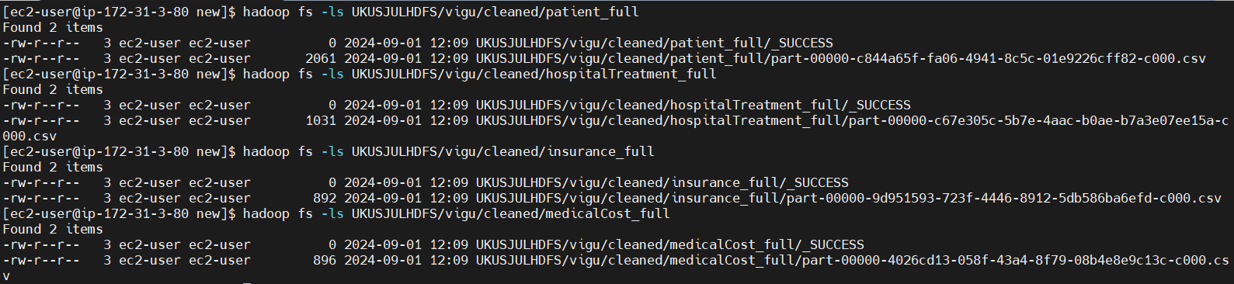
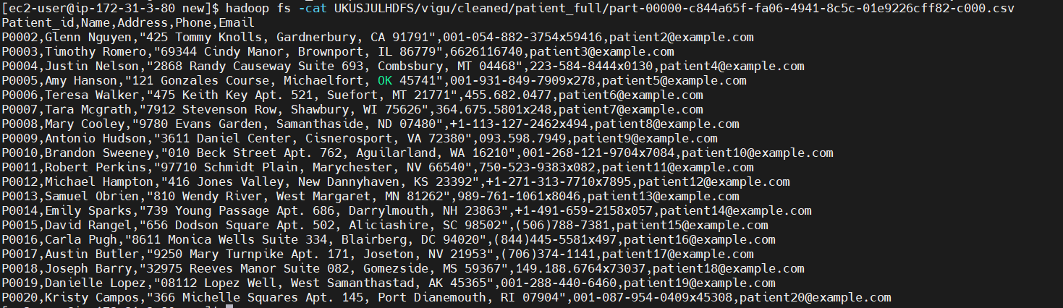

After full load
Data in respective directories

Slide 9
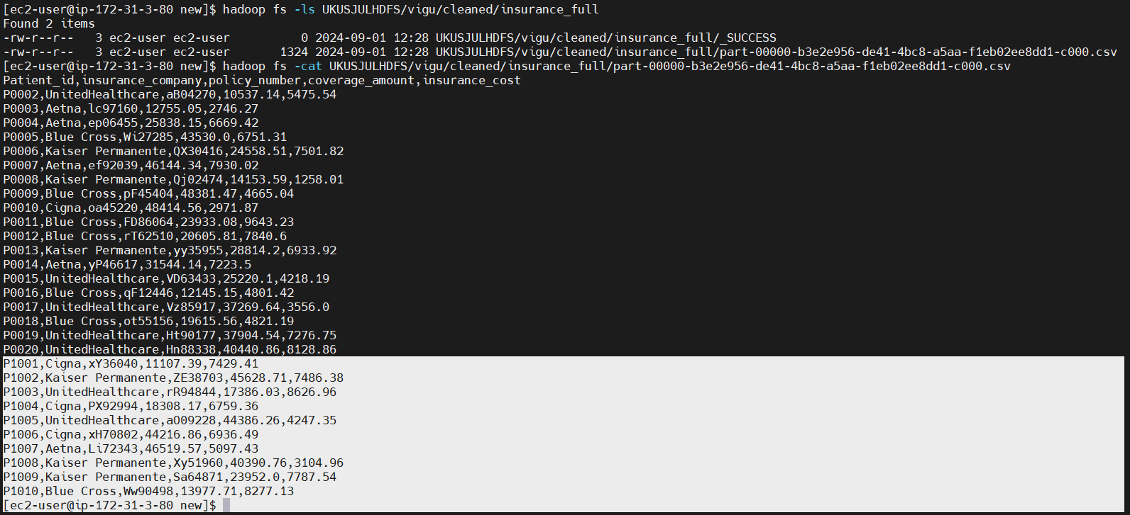
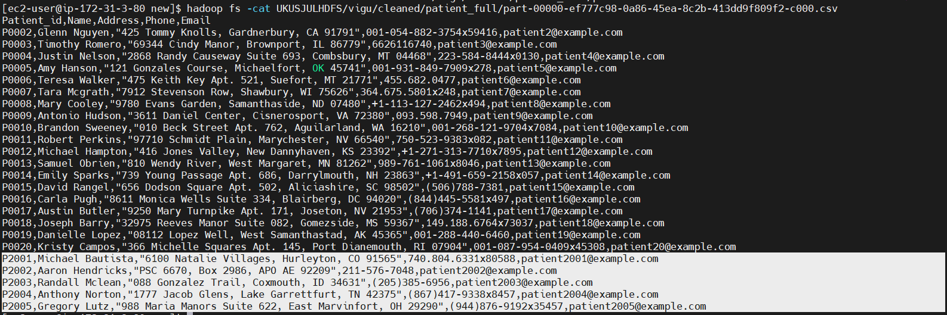
After incremental load
Highlighted the incremental data

Slide 10
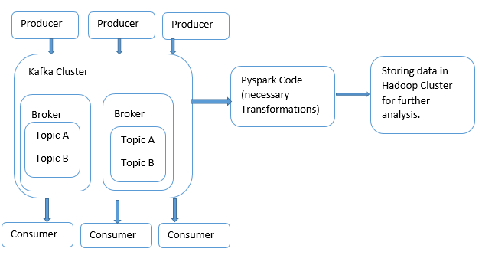
Kafka streaming – real time data processing

Slide 11
Technologies & application
Technology | Description
Spark-Scala | Utilized within IntelliJ IDEA for data cleaning
PySpark | Utilized within python for full load and incremental load operation
Python | Utilized for connecting to DB and create tables and move data to cluster and for data visualization
Hadoop cluster | Managed and interacted for distributed storage and processing of large datasets.
Hive | Utilized for data warehousing and querying large datasets in Hadoop Distributed File systems(HDFS)
Postgresql | Relational Database Management System
Scoop | Injection tool used to inject data from source to HDFS
MobaXterm | Platform for interacting with Hadoop cluster

Slide 12
Challenges Faced
Connecting PostgreSQL using JDBC driver in the Hadoop cluster
Incremental load – while appending incremental data to the existing files in the Hadoop system
Faced issues executing PostgreSQL-connector python library in pyspark
While running Jenkins faced issues for authentication to the Jenkins user.

Slide 13
Future enhancements
Curated data can be stored in HBase, as it provides low latency
Delta Lake enables efficient updates and deletes, facilitating incremental updates to data without rewriting the entire dataset. This saves processing time and resources, especially for large datasets.
Using Docker and Kubernetes streamlines deployment, scaling, and management for improved efficiency and resource utilization

Slide 14
Questions?

